Slide 1
Automation 2:
an AI workflow
What does AI add to the same workflow, and what must a person still do?
Applied AI and Automation | Session 8 of 12
KLAi Professional Learning | Jotham Martin Wambi
Notes:
Welcome. Two sessions ago the rules read words. Last time we set limits for agents. Today the same twelve customer messages go through an AI workflow: the AI sorts them, drafts replies, and a person approves. Nobody builds anything. The results were recorded in advance, and I will always say whose they are. First, three questions from Session 7.
The question for today is this: What does AI add to the same workflow, and what must a person still do? Keep it in mind. At the end of the session we come back to it and see how much more you can say.

Slide 2



Today in one view: what you will leave with
By the end of today you will have
The AI workflow drawn: sort, draft, a person approves, log
Ten real reply drafts checked against the company rules with a written checklist, and what each draft promised or avoided
A side by side comparison of rule, AI and person, with the review time still to be measured, and your decision on what to automate
Notes:
Here is what you leave with today. You can draw the AI workflow with its approval step. You have seen ten real reply drafts checked against the company rules with a written checklist, so you know what each one promised and avoided. And you can compare rule, AI and person side by side and decide what you would automate and what stays with a person.

Slide 3
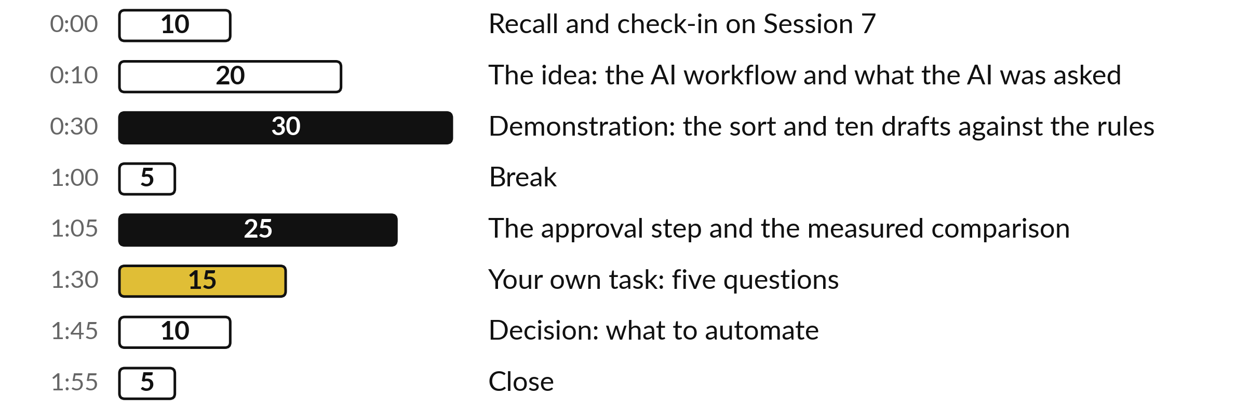
Your two hours: mostly demonstration,
25 minutes for your own task
This is a demonstration: 25 of the 120 minutes are about your own task and decision.
Notes:
Three parts matter most. In the first twenty minutes I draw the AI workflow and show what the AI was asked. Then thirty minutes go to the demonstration: the sort and ten drafts, read against the rules. After the break, twenty-five minutes cover the approval step and the measured comparison, and the rest is your own task and a decision.

Slide 4

Three questions from last time
1. What is the difference between a chat assistant and an agent?
2. What does a boundary for an agent say?
3. What should an assistant do with an instruction hidden inside an email or a message?
Answer aloud first. Then we check together.
Notes:
Three quick questions from Session 7. Answer aloud first, and then we check together. It is a warm-up to bring last time back.
Question one. What is the difference between a chat assistant and an agent? Take a moment.
A good answer is this. A chat assistant answers in a window and takes no action. An agent has a goal and tools such as read, draft, send and pay, and chooses its own steps. That is why it needs permissions and limits.
Question two. What does a boundary for an agent say? Say it to yourself first.
A good answer is this. What it may read, write, send and spend, what a person must approve, what it must never do, and the stop conditions that make it halt and tell a person. The Tool Boundary Sheet records these.
Question three. What should an assistant do with an instruction hidden inside an email or a message? Think about your own task as you answer.
A good answer is this. Treat it as text from outside, do not obey it, and flag it to a person.
If an answer was missing, your own task card or last workbook page has it. Now to today.

Slide 5




Words we use today
Word | What it means
AI workflow | An automation where an AI step reads the message and writes a draft, and a person approves it.
Draft | A reply written by the AI that nobody has sent yet.
Approval step | The point where a person reads a draft and chooses to send, edit or reject it.
UNSURE | The answer we asked the AI to give when it cannot tell, so that a person decides.
Baseline | How the task performs today. It is the number the new way must beat.
Notes:
Five words for today. I give the plain meaning of each, and we use every one of them before the end of the session.
AI workflow. An automation where an AI step reads the message and writes a draft, and a person approves it.
Draft. A reply written by the AI that nobody has sent yet.
Approval step. The point where a person reads a draft and chooses to send, edit or reject it.
UNSURE. The answer we asked the AI to give when it cannot tell, so that a person decides.
Baseline. How the task performs today. It is the number the new way must beat.

Slide 6
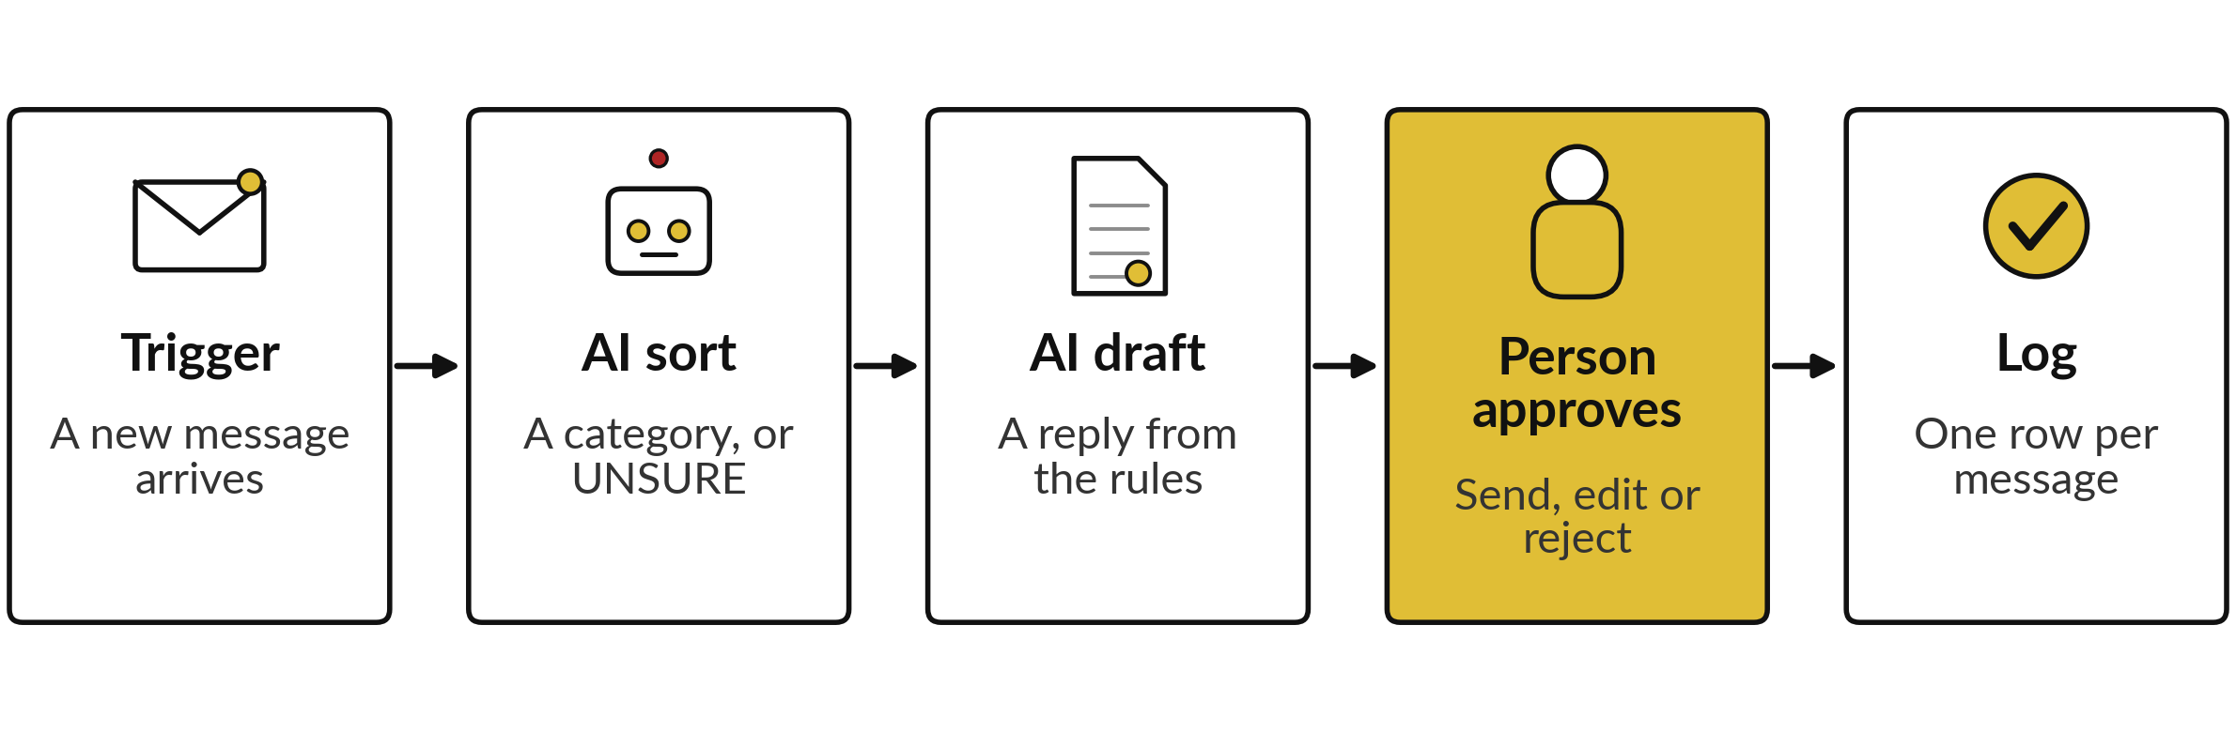
The AI workflow: the AI sorts and drafts,
a person approves, then it is logged
The person sits between the draft and the customer. The sort and the drafts were run separately.
Notes:
Here is the workflow for today. A new message is the trigger, as before. An AI step sorts it into a category, or says UNSURE. A second AI step drafts a reply from the company rules. Then a person reads the draft and sends it, edits it or rejects it.
Only then is the result logged and the reply goes out. Notice where the person sits. The AI never talks to the customer directly. The gold box is the step that makes this safe enough to use. One honest note: the sort and the drafts were separate runs, so this is the shape of a workflow and not one chained run.

Slide 7


Three parts stay the same and three are new
Same as Session 6
New today
The trigger: a new message
The route to a queue
The log of every run
The AI reads the meaning of the text
The AI drafts a reply from your rules
A person approves before sending
The new parts add value, and they add the need for a checker.
Notes:
Compare this with Session 6. On the left, three parts stay the same: the trigger, the route to a queue and the log. On the right, three are new. The AI reads the meaning of the text, which the word rules could not. The AI drafts a reply from your rules, which a rule workflow cannot do at all.
And a person approves before anything is sent. Every new capability also brings a new need for a checker, because an AI can be wrong in ways that read very well.

Slide 8
The AI was given a short instruction,
five rules and five messages
Shortened from the prompt. Claude, two fresh sessions given only the prompt, 4 November 2026, answer key hidden. Not ChatGPT or Gemini.
The rules
1 Photo before a replacement or credit.
2 Credit above UGX 100,000: Manager approves.
3 Finance confirms a payment in one working day.
4 No delivery time without Dispatch.
5 Polite and brief; say what happens next.
The messages
M03, M10, M14, M26 and M32, with the same text you saw in Session 1.
Notes:
This is what the AI was asked. I gave it five company rules and five of our twelve messages, the ones that need a reply from Customer Service. Rule one, a photo before a replacement or credit. Rule two, a credit above one hundred thousand shillings needs the Customer Service Manager.
Rule three, Finance confirms a payment within one working day. Rule four, no delivery time without Dispatch. Rule five, be polite and brief. I also told it to write in the name of Customer Service and called the rules fictional. I ran it twice, in two fresh sessions of Claude on the fourth of November 2026, each given only the prompt, with the answer key hidden.

Slide 9
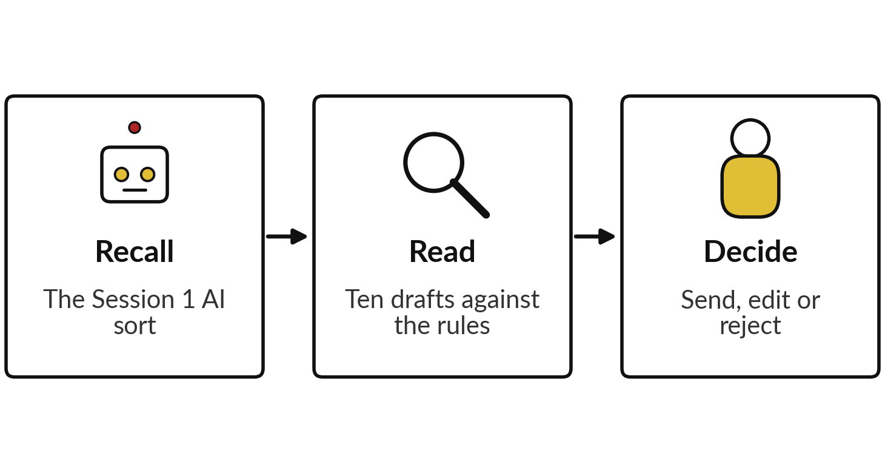
Demonstration: the sort and
ten drafts, read against the rules
I will show
Watch for
What each draft promised.
What each draft avoided.
Where a person would change it.
Notes:
Now the demonstration, and it is recorded. These are real results, not live. The sort comes from three fresh sessions of Claude and the drafts from two, each given only the prompt, all run on the fourth of November 2026 with the answer key hidden. This was Claude, not ChatGPT or Gemini, and another product or another day can differ.
The sort and the drafts were separate runs. I read all ten drafts myself against a written checklist, which comes next, so the judgements are mine, from one reader. Watch what each draft promised, what it avoided, and where you would change it.

Slide 10
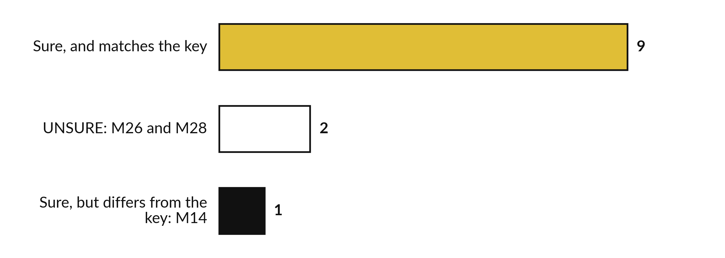
The sort in this workflow: 9 right, 2 sent
to a person, 1 wrong with confidence
Claude, three fresh sessions given only the prompt, 4 November 2026, answer key hidden.
Notes:
First, the sort, from Session 1. Nine messages were answered with confidence and match the key. Two were marked UNSURE, M26 with two topics and M28, which says only please call me. In this workflow those two go to a person. One message, M14, was answered with confidence and differs from the key.
The AI said Complaint and the key says the payment problem comes first. Nothing would flag that one, so the person who approves is the only catch. Three runs gave the same answers, on twelve messages, a small sample.

Slide 11



My count: a draft needs an edit
if it fails any one of five tests
Photo asked for before any replacement or credit.
No delivery time, date or “today” that Dispatch has not given.
A payment says Finance confirms within one working day.
No step claimed as done that nobody did, such as “We have passed”.
No action promised that no rule gives, such as a report to the driver.
Notes:
Before the results, here is my checklist, so you can see how I counted. A draft needs an edit if it fails any one of five tests. One, the photo is asked for before any replacement or credit. Two, no delivery time, date or the word today that Dispatch has not given.
Three, a payment says that Finance confirms within one working day. Four, no step is claimed as done that nobody did, such as we have passed it to Dispatch. We will ask is allowed. We have asked is not. Five, no action is promised that no rule gives, such as a report to the driver.
I applied the same five tests to every one of the ten drafts. Rule five from the prompt, polite and brief, is a matter of judgement, so I read it separately. This is one reader, and you may count differently.

Slide 12
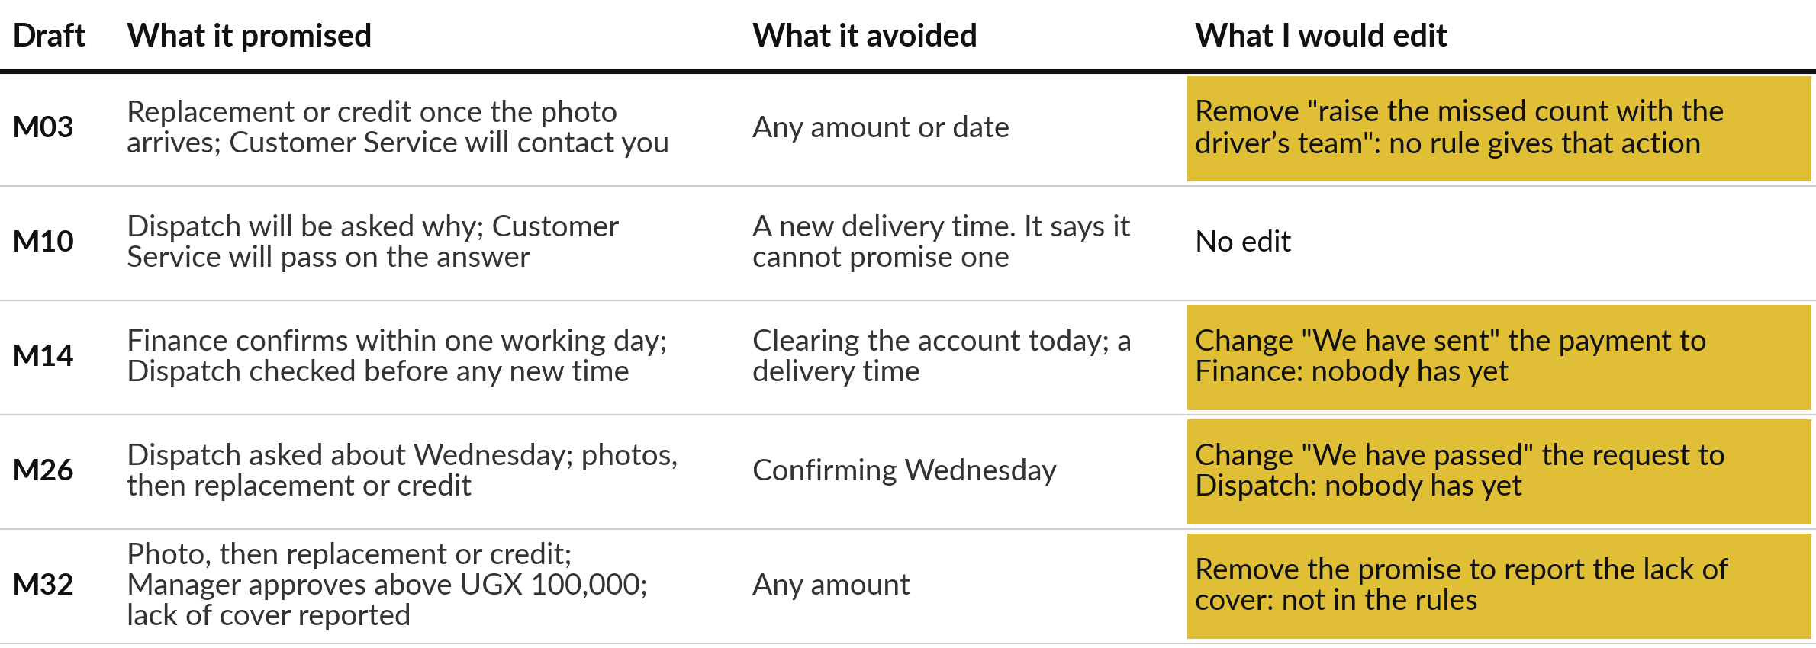
Run 1: four of the five drafts need
an edit, and none broke a rule
Claude, a fresh session given only the prompt, 4 November 2026, answer key hidden. My reading.
Notes:
Here is run one, draft by draft. For each I show what it promised, what it avoided and what I would edit. The M03 draft asks for the photo first, which is right, but adds an action about the driver that no rule gives. M10 needs no edit by my checklist, although it is the closest call: we are taking this to Dispatch says what will happen, not that it has happened.
M14 correctly puts Finance first and promises no delivery time, but it says we have sent the payment to Finance, and nobody has. M26 says we have passed the request to Dispatch, which is the same fault. M32 adds a promise to report the lack of cover. Four of five need an edit. None broke a rule that a checker can test.

Slide 13
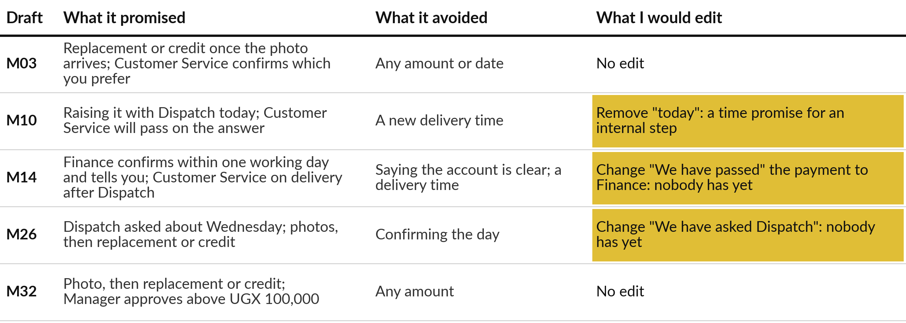
Run 2: three of the five drafts need
an edit, and none broke a rule
Claude, a fresh session given only the prompt, 4 November 2026, answer key hidden. My reading.
Notes:
Run two is a separate fresh chat with the same prompt. M03 and M32 need no edit. M10 says Dispatch is being raised today. That is not a delivery time, but it is a time promise for an internal step, and I would remove it unless Dispatch agrees.
M14 again puts Finance first and says it cannot confirm the account is clear before one working day, which is well judged. But like run one it says we have passed the payment to Finance as if that had happened. M26 says we have asked Dispatch, the same fault.
Three of five need an edit, and again no rule was broken.

Slide 14





Read against the rules, none of the
ten drafts broke a checkable one
Rule | Run 1 | Run 2
Photo before credit (M03, M26, M32) | All 3 ask for the photo first | All 3 ask for the photo first
Manager approves above UGX 100,000 | Named in the M32 reply. Notes: M03, M32 | Named in the M32 reply. Notes: M03, M26, M32
No delivery time (M10, M14, M26) | All 3 say Dispatch must check first | All 3 say Dispatch must check first
Finance in one working day (M14) | Stated: "who confirm payments within one working day" | Stated, and "cannot confirm before then"
Polite and brief (judgement) | All 5 polite. M14 has 7 sentences | All 5 polite. M14 has 6 sentences
No message states the value of a credit. Both runs guessed a credit might pass UGX 100,000, and none promised one.
Notes:
This table checks both runs against the rules. Photo before credit: all six relevant drafts ask for the photo first. Manager approval: both runs name it in the M32 reply, and their notes to the manager list the cases that might need it. But no message gives an amount, so both runs only guessed that a credit might pass the limit.
The AI cannot apply that rule without a figure. No delivery time: all six relevant drafts say Dispatch must check first. Finance in one working day: both state it for M14. Polite and brief is a judgement: all ten were polite, and the two M14 drafts were the longest. These are my readings, from one reader.

Slide 15

Two runs kept the rules and
differed in the extras they added
Run 1: 4 of 5 need an edit
Run 2: 3 of 5 need an edit
M03 adds a driver action
M14 "sent", M26 "passed"
M32 adds a Dispatch report
M10 says "today"
M14 "passed", M26 "asked"
M03 and M32: no edit
Both kept the rules. Both needed a person before sending.
Notes:
When two runs of the same prompt differ, that is a finding. Both kept every rule. But they differed in the extras they added. Run one added an action about the driver and a report to Dispatch. Run two added the word today. Both said that the payment had already gone to Finance, and both said Dispatch had already been asked about M26, which was untrue until a person did it.
The edits vary from run to run, so a fixed checklist beats trusting any single run. That is seven of ten drafts needing an edit, by my checklist. Another reader may count differently.

Slide 16

Before the break: pick one of the ten
drafts, and say whether you would send it
Choose one draft and decide.
Read it against the checklist.
Say send, edit or reject.
Say what you would change.
Notes:
Before the break, each of you speaks. Pick any one of the ten drafts on the slides. Read it against the checklist. Then say aloud whether you would send it as it is, edit it or reject it, and what exactly you would change. You may disagree with my readings.
If you do, tell me, because I would like to know where another reader sees a problem that I missed.

Slide 17
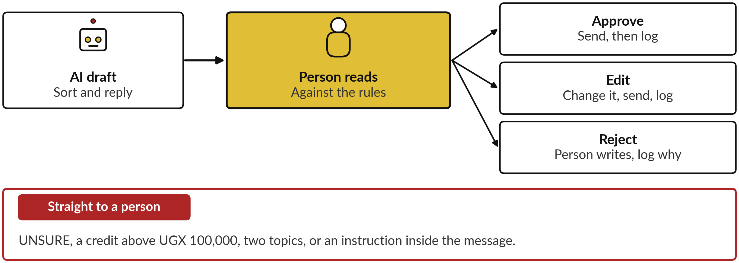
The approval step: a person reads
every draft before anything is sent
Notes:
Here is the approval step drawn. The AI draft goes to a person, who reads it against the rules. There are three outcomes. Approve, and the reply is sent and logged. Edit, and the person changes it first. Reject, and the person writes the reply and logs why.
Some cases skip the AI draft altogether and go straight to a person: an UNSURE sort, a credit above one hundred thousand shillings, a message with two topics, or an instruction hidden inside a message, which you met in Session 7.

Slide 18






The approver’s six questions for every draft
Is the photo asked for before a credit?
Above UGX 100,000? The Manager approves.
Is any delivery time promised without Dispatch?
For a payment: Finance in one working day?
Does it say a step is done that nobody did?
Are the name, tone and length right?
Notes:
This is the approver’s checklist, built from what we just read. Is the photo asked for before a credit?
Is the credit above one hundred thousand shillings, so that the Manager must approve?
Is a delivery time promised without Dispatch?
For a payment, does it say Finance confirms within one working day?
Does it say a step is done that nobody did, like we have sent your payment?
And are the name, tone and length right?
The AI was not given the customer’s name, so every draft opens with Dear customer or Hello. A person adds the name.

Slide 19
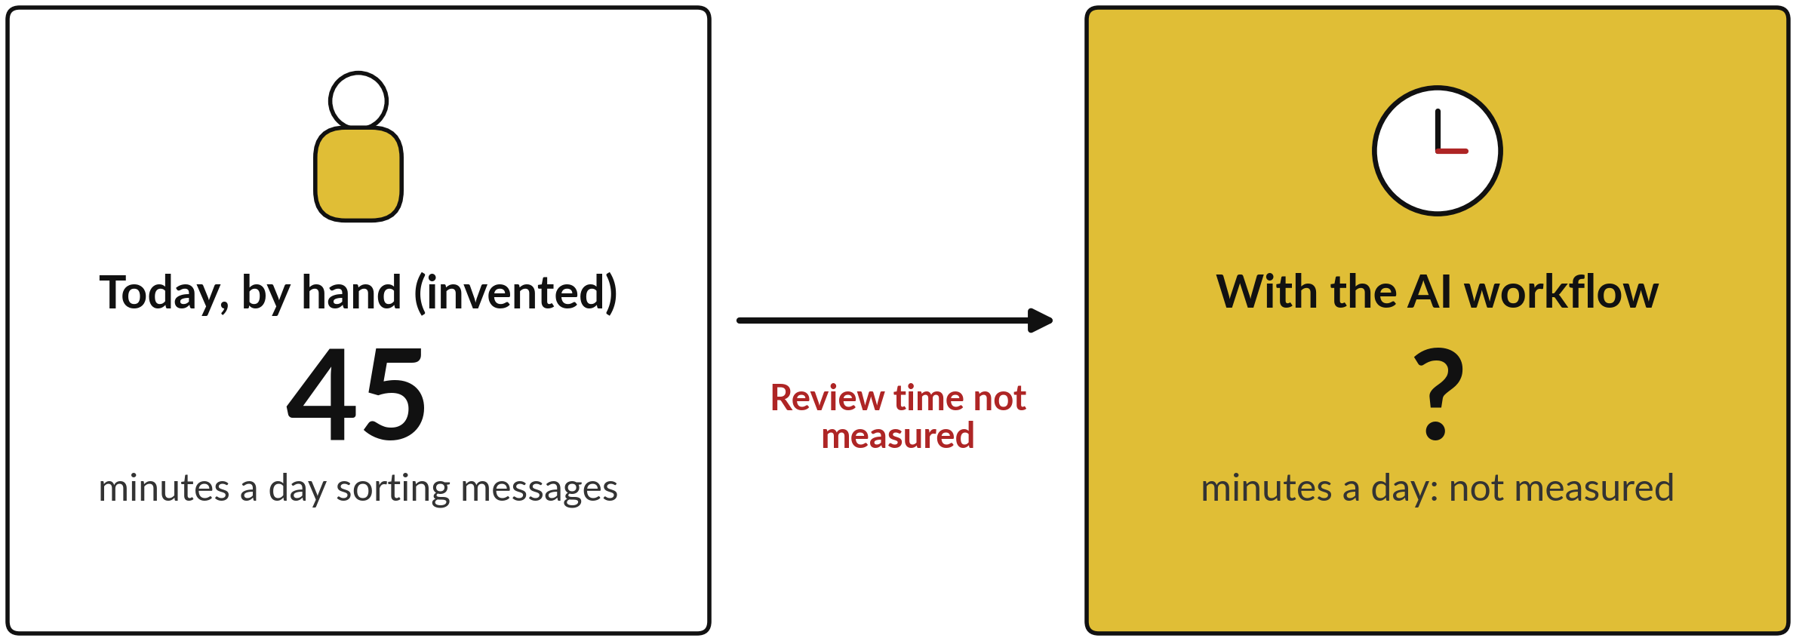
An example baseline is 45 minutes a day, and
the saving is unknown until the review is timed
45 minutes: an invented example row on the Session 1 practice slide. Nothing was timed.
Notes:
Now the baseline. On the Session 1 practice slide, the example row for sorting customer messages says forty-five minutes a day. That is an invented example for the arithmetic, and nobody measured it. The AI answers in seconds, but nobody has measured how long a person takes to read and check the answers and the drafts, so I claim no saving.
Session 11 tries three assumed review times in the arithmetic. To know yours, time your own task.

Slide 20


Rule, AI with a person, and a
person alone, set against the key
Method | Time to process | Matches the key (different measures) | Drafts needing an edit | Cost drivers
Rule (Session 6) | Seconds | 7 of 12 queues with the payment rule | None: it cannot write | Word lists and their upkeep
AI, a person checks | Seconds to answer. Checking: not measured | 9 of 12 match, 2 flagged, 1 differs | 7 of 10, by my checklist | Charges per use; the checker’s time
A person alone | Class time from Session 1; example 45 minutes a day (invented) | Your class score from Session 1 | Writes every reply; not timed | Staff time and waiting
Not like for like: the rule by queue, after I chose its words from these 12; the AI by category. Claude, 4 Nov 2026, key hidden. Neither predicts a real month.
Notes:
The side by side. The rule takes seconds and puts seven of twelve in the right queue once the payment rule is added. It cannot write a reply. The AI answers in seconds, matches the key on nine, flags two and differs on one. Seven of ten drafts needed an edit by my checklist, and the checking time was not measured.
The person alone has the class time and score from Session 1 and an invented example of forty-five minutes a day. The nine and the seven are not like for like. The rule is scored by queue, after I chose its payment words from these same twelve messages.
The AI is scored by category. Claude ran on the fourth of November 2026, not ChatGPT or Gemini, and neither number predicts a real month.

Slide 21
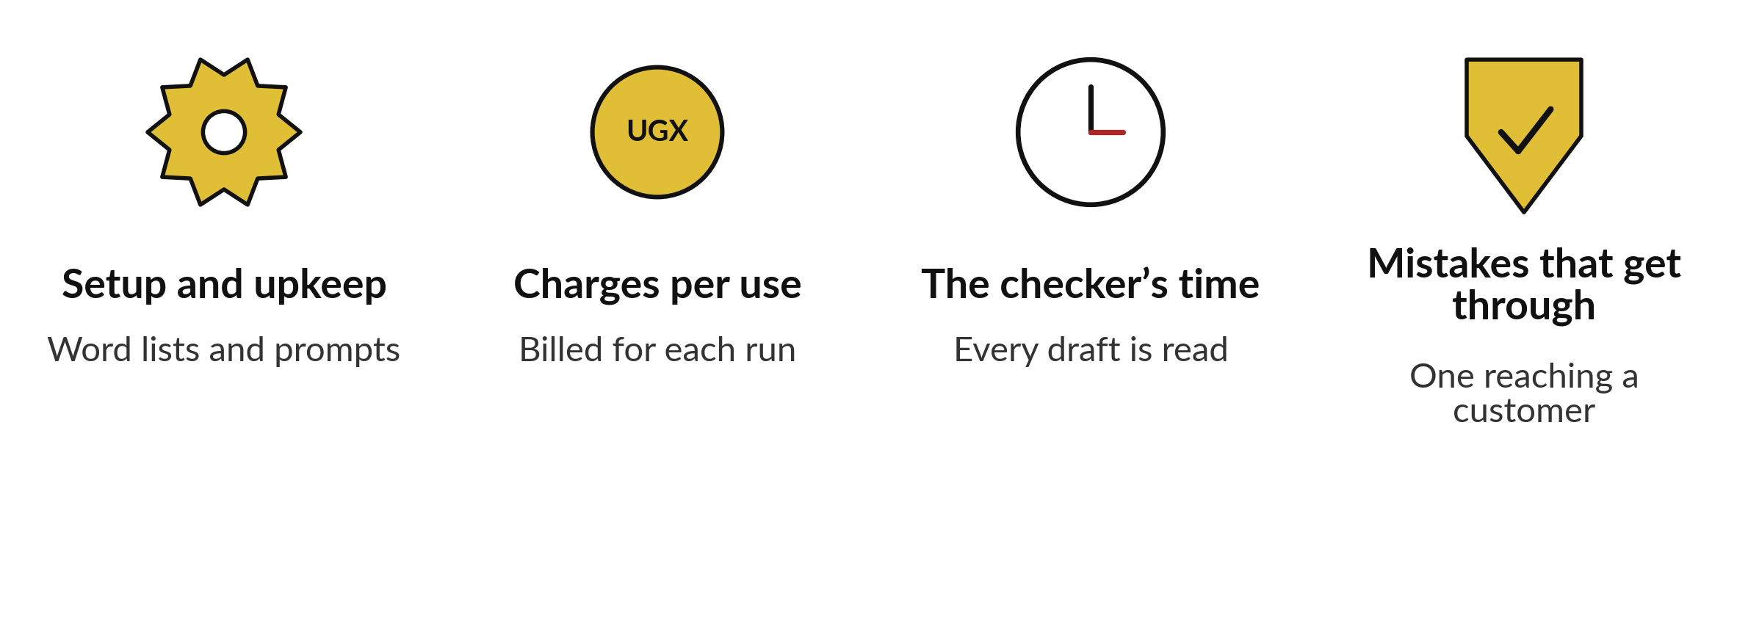
What drives the cost: upkeep, charges
per use, the checker’s time and mistakes
No prices here. Ask a vendor about each.
Notes:
Four things drive the cost of any of these workflows, and I quote no prices. First, setup and upkeep: someone keeps the word lists and the prompts current. Second, charges per use, which are what the tool and the AI provider bill for each run. Plans change, so ask for them in writing.
Third, the checker’s time, because every draft needs a reader, and that time is often the biggest cost. Fourth, the cost of the mistake that gets through to a customer. A vendor who talks only about the first two is leaving out the last two.

Slide 22

Ask five questions of your
own task before you add AI
Who approves each result, and can they say no?
Which cases go straight to a person?
What does a wrong result cost, in UGX and in trust?
How will you measure time and errors, before and after?
What would you paste in, and is it safe to share?
Notes:
Take fifteen minutes for your own task from Session 1. Answer these five questions in your workbook. Who approves each result, and can they say no?
Which cases go straight to a person?
What does a wrong result cost, in shillings and in trust?
How will you measure time and errors before and after?
And what would you paste into an AI tool, and is it safe to share?
If you cannot answer the first or the last, the task is not ready for an AI workflow. I will come round and read your answers with you.

Slide 23





My recommendation for NVF: rules for payments,
AI for sorting and drafts, people for money
Step | Who does it | Why
Payment words | A rule: to Finance first | Fixed words, same answer every time
Sorting the rest | AI, with UNSURE to a person | 9 of 12 right in one set of three runs
Mixed cases such as M14, M26 | A person | Two topics. The AI said Complaint for M14
Drafting replies | AI drafts, a person approves each | Rules kept in both runs. 7 of 10 needed edits
Credits above UGX 100,000 | The Customer Service Manager | No amount in the message, and policy says so
Sending | A person | Nothing leaves without approval
A recommendation, not a measured result. Twelve messages for the sort, five messages in ten drafts for replies. M14 and M26 were drafted to test the rules.
Notes:
Here is my recommendation for Nile Valley Foods, and it is a recommendation that I did not measure. Payment words go to Finance by a rule, because the words are reliable. The AI sorts the rest, and UNSURE goes to a person. Mixed cases such as M14 and M26 stay with a person.
The AI drafts replies and a person approves each one. Credits above one hundred thousand shillings go to the Customer Service Manager. And a person sends. This rests on twelve messages for the sort and five messages, ten drafts from two runs, for the replies. M14 and M26 were drafted to test the rules, and this workflow would send them straight to a person. Test it on your own messages first.

Slide 24




Decision: what you would automate
and what stays with a person
For your own task, which step goes where?
Rules
AI drafts, a person approves
A person only
Not yet
Fixed words and a cheap wrong route.
Meaning matters, and you can check every result.
Money, trust or law is at stake.
No key to check against, or no owner.
Write the step, your choice and one reason. It becomes the first line of your policy.
Notes:
Time to decide. Take your own task and split it into steps. For each step, choose. Rules, if the words are fixed and a wrong answer is cheap. AI drafts and a person approves, if meaning matters and you can check every result. A person only, if money, trust or the law is at stake.
Or not yet, if you have no key to check against or no owner. Say one step and your choice aloud, with one reason, and write it down. In Session 9 this becomes the first line of your company AI use policy.

Slide 25
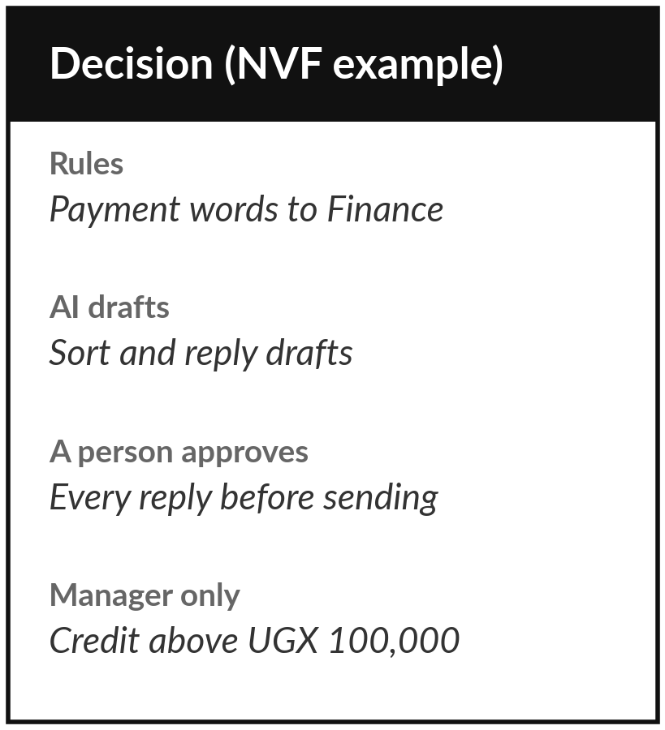
Keep your decision, and bring your
own task to the policy session
What you keep from today
Your workbook page: the five questions answered for your own task, and your decision on what you would automate and what stays with a person.
Our question today
What does AI add to the same workflow, and what must a person still do?
Next session
Session 9: Your AI use policy. Optional: bring any rule your company already has about using AI or sharing data.
Notes:
Save your workbook page with your five answers and your decision. Optional before Session 9: bring any rule your company already has about using AI or sharing data, even an informal one. In Session 9 you write your company AI use policy, and today’s decision is its first line: what is automated, and what a person always does.
We began with this question: What does AI add to the same workflow, and what must a person still do? Before you go, say in one sentence what you can now say about it.

